Slide 1

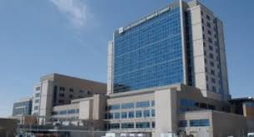
A Case for Advanced Analytics Should be Adoption:
The Case of Intermountain Healthcare
Notes:
Job decision. Personal decision. Big consequences. Scenario. Don’t know for sure. What that information shows will probably happen a year from now 5 years from now and this is important for your decision. The person can give you insights to help you make a better decision. In which situation would you rather be?
Don’t use “well”, “uh”, “so”,
Speak slowly

Slide 2

UNC HealthCare Stage 7 designation by HIMSS

Slide 3
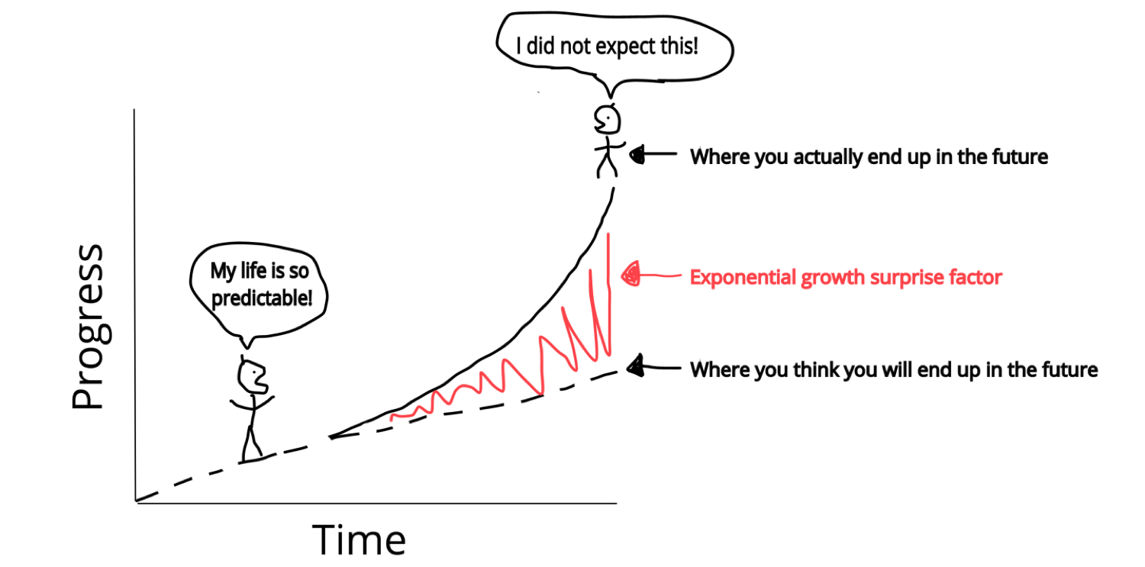
Technology is changing literally daily: This has implications for how analytics teams operate and how they must grow.
Notes:
In the past 10 years there have been incredible advances made in data and data analytics. The situation is changing fast. In past 2 weeks, I read that a computer outperformed Doctors in diagnosing illness. Computers got it right about 80% of time. But physicians should not feel alone. We data scientists and analysts, a few days later, I saw the example that Google had released their own machine learning models, that allows anyone, even non-experts to create their own machine learning algorithms. Talked with top data scientists, follow this closely, and read widely. No one that I’ve talked to believes that human judgement will be replaced anytime soon (who would trust a computer to make a big decision for you). And that’s because the most critical piece of making sure that advanced analytics succeeds is not the data or the information but the people – the leaders, the users, the analysts – in the organization. The people and process.

Slide 4
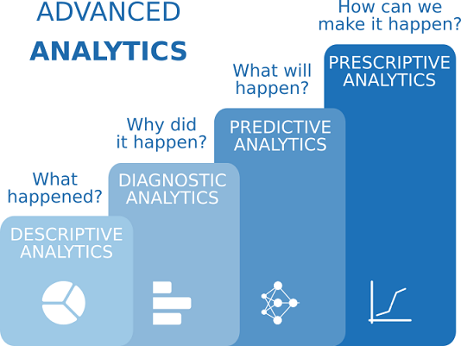
Notes:
Aristotle. Prior. Posterior Analytics. Comes from Greek analy meaning to “loosen up”. Break it apart and combine it back together.

Slide 5
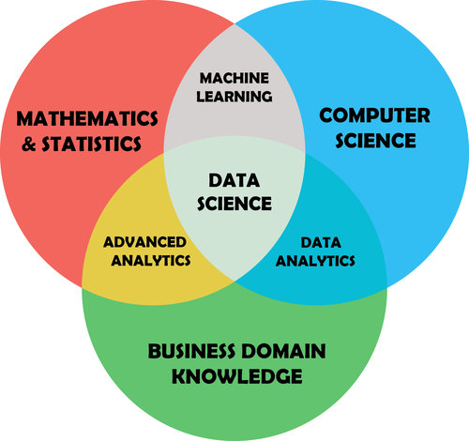
Artificial Intelligence
Core idea: raw data transformed to
Provide insights
Predict the future
Inform decision making
Notes:
Share 3 features.
Could be different names for these different fields.
These fields help us make the world a better place.

Slide 6
Why the Intermountain Case?
It’s recent
Reputable source (MIT Sloan Review)
Enterprise-wide, lots of context provided
Known for being a leader in healthcare analytics
Intermountain has been very successful
Notes:
Changing so rapidly that by time a case is published, moved on to next thing.
40 different
academic articles and
business briefs and
white papers.
Many recent cases written by business involved or short. There are not a lot of academic case studies. Many cases focus on narrow adoption, not entire enterprise.
Elder Research
McKinsey
“there is a paucity of information on evidence of real-world use of Big Data analytics in healthcare. This is because, the usability studies have considered only qualitative approach which describes potential benefits but does not take into account quantitative study.
-International Journal of Medical Informatics, June 2018

Slide 7

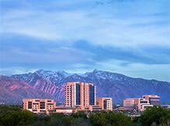
Nonprofit system, founded 1975
Located in Utah & Idaho
22 hospitals, 185 clinics
Notes:
Sam Ransbotham.
Intermountain Health Care
UNC Health Care

Slide 8
Intermountain Context
Long history in data analytics
Invested early in data quality and systems
A culture of analytics collaboration
Notes:
Electronic Health Records system.
1986 hired statistician to make quality improvements.
Ransbotham.
Team driven culture
gentle peer pressure
Question data

Slide 9
Intermountain: Examples of Value-Added
Problem | Analytics Solution | Benefit
Clinicians miss warning signs on different vitals. | “Algorithms” | Health / lives, flag patients at high risk of readmission.
Challenges analyzing cost. | “ProComp” system provided cost-benefit analysis, e.g. bowel surgery staplers. | $25 million dollars saved. In bowel case, $235,000.
Ears, eyes, nose, throat: Price differential for 4 cauterization methods during tonsillectomy. Does method matter? | Statistical group comparison – ANOVA? | Conversations with doctors lead to further survey [indirect benefit].
Notes:
Care Process = Algorithms. Pulls readings from patients vital signs and sends an email telling which patients are at risk for heart failure. Helps track things that people might miss.
P10
Analyzing Cost, p. 11 -12. Supply Chain
P10 – Ears, eyes, nose, throat. See p. 4 quote.

Slide 10

2016-2018: Intermountain Healthcare Continues to leverage the latest technology
Data mining insights on colon surgery and mortality prediction (Ayasdi)
Medical imaging (Zebra)
Notes:
“Data-driven decision making has improved patient outcomes in Intermountain’s cardiovascular medicine, endocrinology, surgery, obstetrics and care processes — while saving millions of dollars in procurement and in its supply chain.”
-MIT Sloan Management Review
http://dhimss.brightcovegallery.com/detail/videos/all-himss17-video/video/5333174592001/ayasdi:-improving-mortality-prediction-at-intermountain-healthcare?autoStart=true

Slide 11
Why Intermountain Succeeds: Recommendations based on the case and 10+ years in analytics across organizations
Invest heavily in and develop data infrastructure and data
governance. This is not always a visible endeavor, might take different forms depending on institutional culture, and might be more or less formal. Great data in helps ensure great analysis out, and is a huge part of the battle.
Strongly support analyst professional development in a) soft skills – especially analytic translation, b) general problem solving, and c) staying ahead of the technology curve. Set aside lots of time for analyst professional development.

Slide 12
Recommendations Continued
Embed analytics in the larger organization. Create and foster small, nimble groups to tackle problems collaboratively. Encourage discussion about the data. Every problem is different. Analysts need as much context as possible not only to be able to solve problems but to have the vision to identify problems that other stakeholders might not realize are solveable.

Slide 13

Fostering Process and Teamwork: The Key to the Successful Adoption of Advanced Analytics

Slide 14
A Day in the Life of a Data Analyst: Intermountain Health Care
https://m.youtube.com/watch?v=xbTqJiZ8nhA

